Slide 1
Town Hall for U.S. Citizens
New Delhi Consular District
September 13, 2022

Slide 2
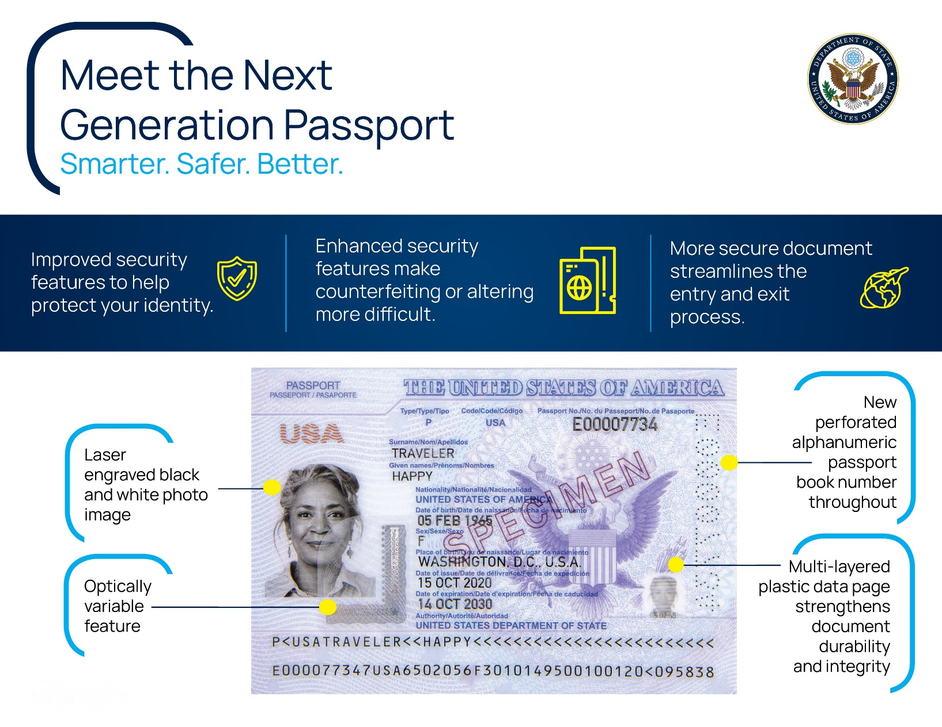
Introducing the Next Generation Passport

Slide 3
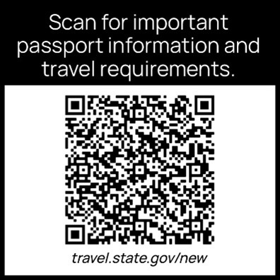
Introducing the Next Generation Passport
The Next Generation Passport book (NGP) is a modernized U.S. passport book first issued in 2021
NGPs use new technology to produce a more robust passport with enhanced security features
Do you need to change or upgrade your passport?
The role of the U.S. Consulate General in Hyderabad
Don’t forget to sign and date your application!
Don’t forget your Blue Dart demand draft!
Why is there a QR
code on the back?
Notes:
Do I need to change or upgrade my passport? Can I request an NGP?
No, you do not need to upgrade your passport. When your passport expires, your next passport will be an NGP if that is what is being issued wherever you reapply. The Consulates in Mumbai, Hyderabad, and Kolkata are already issuing these passports and New Delhi and Chennai will begin issuing these by the end of the year. Both the existing ePassports and the NGPs can be used for international travel and remain valid until their date of expiration.
In order better process adult passport renewals, we are changing some things here in Mission India. U. S. Consulate General Hyderabad is moving into a new state of the art facility in the new year. Beginning March 1, all mail-in adult passport renewals will be processed through Hyderabad. That means that adult U.S. citizens will mail their applications directly to Hyderabad. As always, you’ll need to make sure to sign and date your passport application and include your Blue Dart draft before mailing your application packet!
Also, don’t forget that pay.gov is now available to pay for passport renewals using credit cards and electronic wallets.
Some of you may already have NGPs and have seen a QR code on the back of your passport.
We are placing Quick Response (QR) code stickers on the back of passport books to give you easy access to important passport and travel information. You may remove the sticker, though we recommend keeping it on, so you have quick and easy access to travel.state.gov. If you scan the code using the camera on your mobile device, it will link you to our website. The QR code is identical on all passport books, does not contain any personally identifiable information, nor does it change the way border officials, airlines, and others review your document.

Slide 4
How Do I Look?
Passport Photograph Dos and Don’ts
DO submit a photo taken within the past six months
DO makes sure the photograph is 2” by 2” and that your head is centered
DO ensure children are alone in the photograph and that the child’s eyes are open.
DO have a plain white or off-white background
DO face the camera head on and have a neutral expression
DO NOT wear any head coverings that are not for a religious or medical purpose.
DO NOT use social media filters
DO NOT wear glasses of any kind

Slide 5





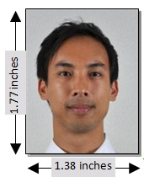


Photo Examples
Photo Quality
Head Position
Size
Head Coverings
Notes:
Make sure the photo is not over or underexposed and has a white or off-white background. Make sure the head is centered in the photo and that the photo is the correct size. Any religious head coverings need to show the entire face, including eyes and the full eyebrow on each side. Religious head coverings should not cast shadows on the face.

Slide 6








Photo Examples
Background
Children
Head Angle
Expression
Notes:
Children must be alone in the photo with eyes open if possible (some exceptions for newborns). Faces must face the camera straight on with a neutral expression, but a small smile is fine!

Slide 7

Time to VOTE
Did you know:
  You can mail your ballot using US postage directly from the drop box at the Embassy!
  You can mail your ballot to the Embassy and we will mail it to the United States (please allow four weeks).
  Even if you have never resided in the United States you may still be eligible to vote.
Other questions can be answered online at FVAP.gov where you can also request your absentee ballot with the Federal Post Card Application (FPCA)
Notes:
You can send pre-addressed and stamped ballots to: American Citizens Services, Shantipath, Chanakyapuri, New Delhi 110021

Slide 8
When Do States Mail Ballots?
> 45 Days Before the Election
Arkansas
Delaware
Kentucky
Minnesota
North Carolina
Pennsylvania
South Dakota
Tennessee
West Virginia
Wisconsin
45 Days Before the Election
Alabama
Idaho
Indiana
Louisiana
Michigan
New Jersey
Oklahoma
Rhode Island
Texas
Virginia
Wyoming
30-45 Days Before the Election
Connecticut
Florida
Illinois
Maine
Maryland
Massachusetts
Mississippi
Missouri
Nebraska
New Hampshire
New York
North Dakota
South Carolina
Vermont
< 30 Days Before the Election
Alaska
Arizona
California
Colorado
Georgia
Hawaii
Iowa
Kansas
Montana
New Mexico
Ohio
Oregon
Utah
Washington
Notes:
Please remember that most states will email you your ballot! Contact your town clerk, county election office, or FVAP.gov to find out more.

Slide 9

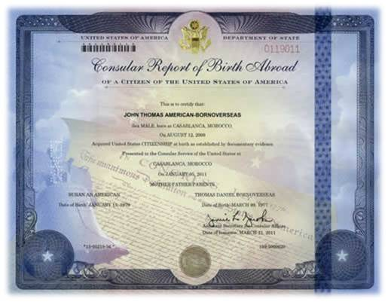
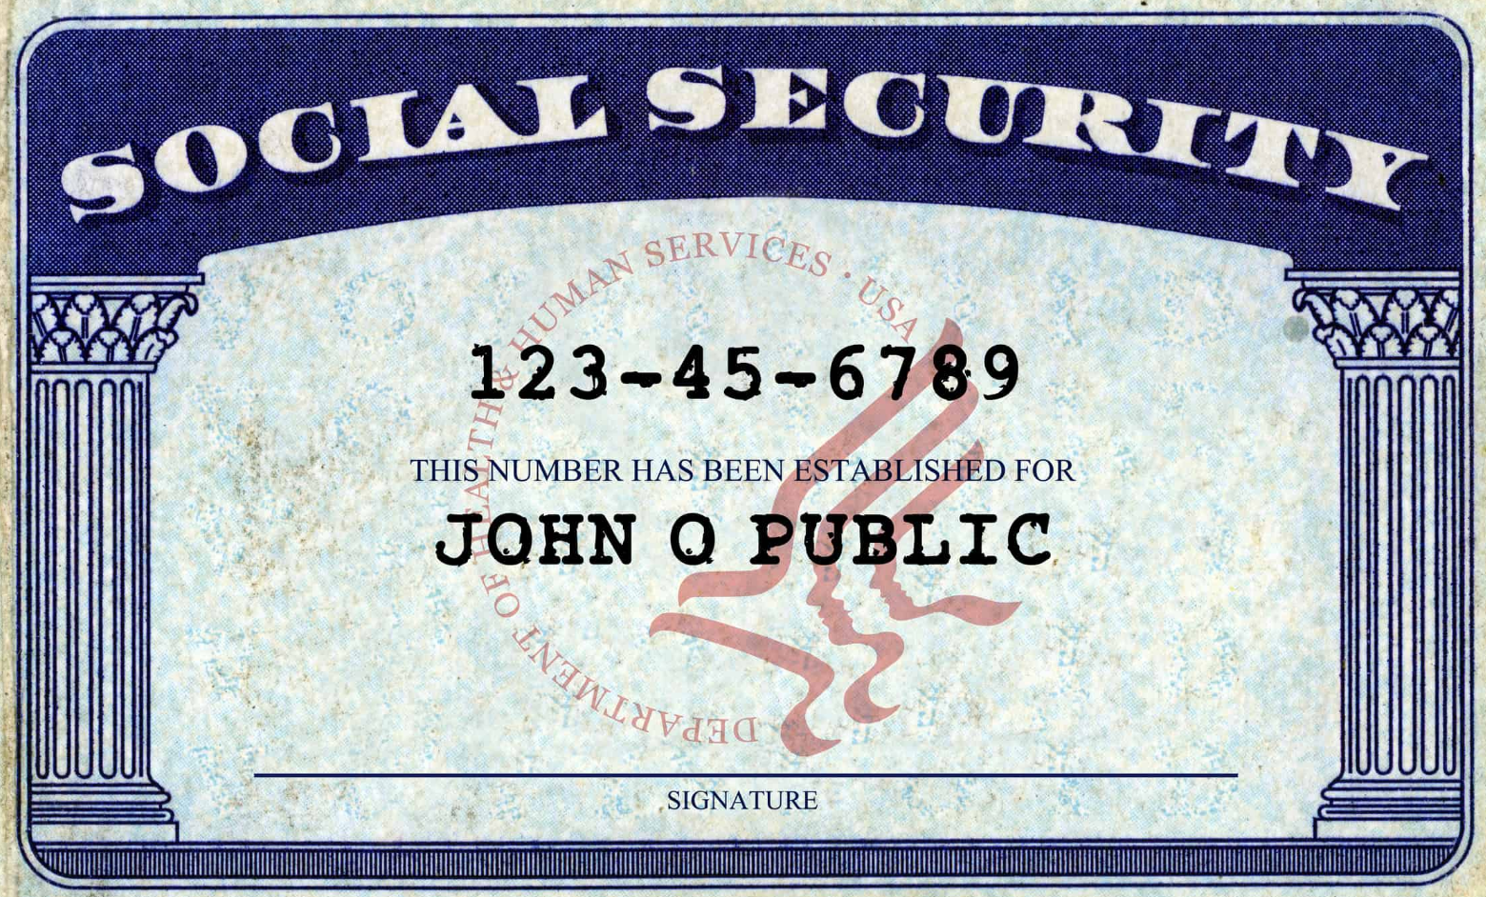
Information for Expecting Parents
Consular Report of Birth Abroad
How can you transmit citizenship to your child?
What if only one parent is a U.S. citizen?
What if both parents are U.S. citizens?
What kinds of proof does the Embassy accept?
Who needs to come to the appointment?
What else should you bring?
The Role of the FRRO and Social Security Administration
Your child must be registered with the FRRO in order to leave India.
You will face a fine if your child has any nationality other than Indian
The embassy cannot assist with the issuance of OCI cards
Why do you need a social security number?
How do you get one?
Notes:
How do I transmit citizenship to my child?
If you are a U.S. citizen and were a citizen at the time of your child’s birth, you may be able to transmit citizenship to your child.
What if only one parent is a U.S. citizen?
If one parent is a U.S. citizen, then that parent needs to prove that he or she has been physically present in the United States for at least five years, with two of those years after the age of 14. The five years are cumulative and do not have to be continuous.
What if both parents are U.S. citizens?
If both parents are U.S. citizens, then one of the parents needs to prove any previous residency in the United States, prior to the birth of the child.
What kinds of proof do you accept?
There are many ways to prove your presence or residence in the United States. These include old passport stamps, bank records showing transactions within the United States, school transcripts, and many other items. It is important to remember that rental agreements, mortgages, utility bills, and drivers licenses are not proof of presence as you could have all of those things and still live outside of the United States. However, they do prove residence.
Please keep in mind that physical presence and residency are very different. Presence is the time actually standing in the United States regardless of why visiting or a person’s immigration status and does not include any time spent abroad. Residency is defined as someone’s actual dwelling place – where the work, study, and go about the basics of everyday life. It does not include vacations to the United States.
Who needs to come to the appointment?
At least one parent and the child. A Consular Report of Birth Abroad can be issued with just one parent’s signature, but a passport cannot. Ideally both parents would be present for the interview, but especially the transmitting parent.
What else should we bring?
The child’s Indian birth certificate
Evidence of the parent(s)’ U.S. citizenship and identity
Evidence of the U.S. citizen parent(s)’ physical presence or residence in the U.S. prior to the birth of the child
Parent(s) marriage certificate, if applicable
Evidence of the termination of any previous marriages of the parents
If a person other than a parent of the child is applying for the CRBA, the person must present a certified copy of legal guardianship or a notarized affidavit from the parent(s) authorizing the person the make the application.
One 2×2″ passport-style photo of the child
Filing fee of $100 for the CRBA (and an additional $135 if a U.S. passport is desired).
Form DS-2029
The FRRO
Once you have your child’s US passport, you must apply for an exit permit for your child at the Foreigner’s Regional Registration Office, or FRRO. There will be a fine for your child entering India without a visa! Your child will be fined up to Rs. 50,000 for being born in India without a visa if they are later recognized as a U.S. citizen. He or she will not be able to leave the country without paying the fine and receiving either a visa or exit permit. Please remember that India does not permit dual citizenship. The exit permit can be filed online.
Social Security
If your child ever wants to study or live in the United States, he or she will need a social security number, and even if you don’t foresee this happening it is still a good idea to get your child a social security number now. To do this, you need to apply through the Social Security Administration office at US Embassy Manila in the Philippines. You will receive further instructions on this when you get the Consular Report of Birth Abroad in the mail. If you are going to the United States anytime soon, it might be preferable to apply in person at your local Social Security office as we have had anecdotal reports of wait times from Manila being up to seven months.

Slide 10
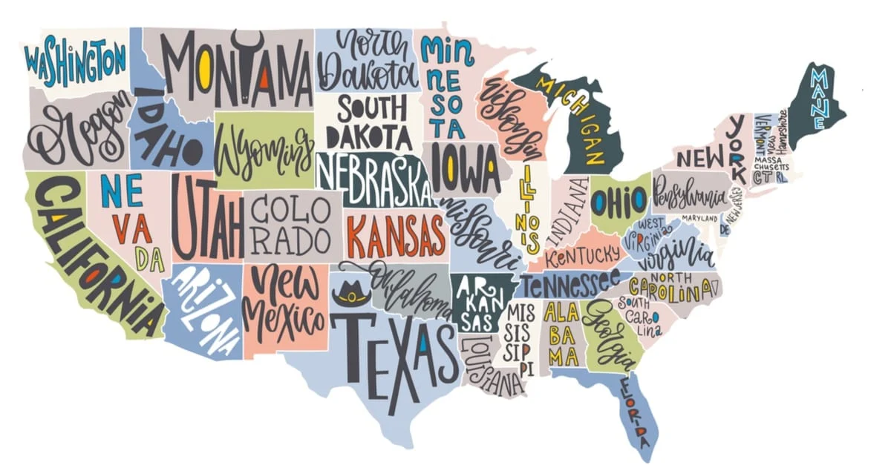

Town Hall Series 2022-2023
October 2022: Visas- Immigrant and Non-immigrant
November 2022: Health and Safety in India for U.S. Citizens
December 2022: TBD
Spring 2023: TBD
Summer 2023: TBD
Notes:
We are reviewing your ideas and more information on upcoming Town Hall topics will be coming out shortly!

Slide 11
www.slido.com
#newdelhitownhall

Slide 12
THANK YOU!
For more information, please visit us at
in.embassy.gov/u-s-citizen-services
or email us directly at
acsnd@state.gov
Notes:
For further questions please email us at the address above. The answers to many common questions can also be found on our website.

